Slide 1
Part III: Simulation
This part includes Chapters 5 and 6.
This lecture is partially based on notes from T. Issariyakul, E. Hossain, and Sung Park

Slide 2
Chapter 5: An Introduction to NS2
Textbook: T. Issariyakul and E. Hossain, Introduction to Network Simulator NS2, Springer 2008.
1

Slide 3
Outline
•
•
•
•
•
Overview
Installation
An Example
Incorporate C++ Modules into NS2
Summary
Textbook: T. Issariyakul and E. Hossain, Introduction to Network Simulator NS2, Springer 2008.
2

Slide 4
Overview: Network Simulation
• 3 Simulation Main Steps
1. Design and Implementation
• Things to simulate
• Assumptions
• Performance measure
• Code Implementation
2. Simulation
• Network Configuration Phase
• Simulation Phase
3. Result Compilation
• Debugging and Tracing
• Compute performance measures
Textbook: T. Issariyakul and E. Hossain, Introduction to Network Simulator NS2, Springer 2008.
3
Notes:
compilation /ˌkɒmpɪˈleɪʃn/ 编绘

Slide 5
Overview: NS2 software
NS2 = Network Simulator Version 2
Collection of various protocols at multiple layers
  TCP(reno, tahoe, vegas, sack)
  MAC(802.11, 802.3, TDMA)
  Ad-hoc Routing (DSDV, DSR, AODV, TORA)
  Sensor Network (diffusion, gaf)
  Multicast protocols, Satellite protocols, and many others
Collection of various Codes are contributed from multiple
research communities
  Good: Large set of simulation modules
  Bad: Level of support and documentation varies
    For example, different modules may depends on different versions of gcc and g++.
The source code and documentation is currently maintained by VINT project at ISI (http://www.isi.edu/nsnam/ns/)
Textbook: T. Issariyakul and E. Hossain, Introduction to Network Simulator NS2, Springer 2008.
4
Notes:
compilation /ˌkɒmpɪˈleɪʃn/ 编绘

Slide 6
Overview: NS2 simulation approach
ns-2 is an discrete event driven simulation
  Physical activities are translated to events
  Events are queued and processed in the order of their scheduled occurrences
  Time progresses as the events are processed
Time: 1.5 sec
Time: 1.7 sec
1
2
Time: 2.0 sec
Time: 1.8 sec
Textbook: T. Issariyakul and E. Hossain, Introduction to Network Simulator NS2, Springer 2008.
5
Notes:
compilation /ˌkɒmpɪˈleɪʃn/ 编绘

Slide 7
Overview: NS2 simulation approach
Dispatch an installed event
One unique scheduler
(install events)
Trigger a new event
TX Pkt Event @ 1.5sec
RX Ack Event @ 2.0sec
Node 1 Module
Event Queue
TX Pkt Event @ 1.5sec
RX Pkt Event @ 1.7sec
TX Ack Event @ 1.8sec
RX Ack Event @ 2.0sec
Simulation Finished!
Node 2 Module
RX Pkt Event @ 1.7sec
TX Ack Event @ 1.8sec
Textbook: T. Issariyakul and E. Hossain, Introduction to Network Simulator NS2, Springer 2008.
6
Notes:
compilation /ˌkɒmpɪˈleɪʃn/ 编绘

Slide 8
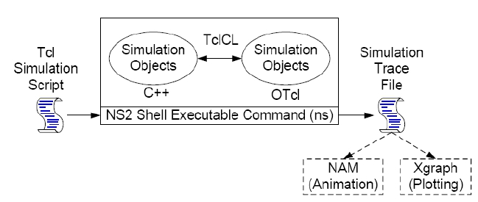
Overview: NS2 Architecture
• Consists of
– C++: Define internal mechanism (backend)
– OTcl: Set up user interface (frontend)
    OTcl, short for MIT Object Tcl, is an extension to Tcl/Tk for object-oriented programming
– TclCL: Connecting C++ to OTcl
7
Textbook: T. Issariyakul and E. Hossain, Introduction to Network Simulator NS2, Springer 2008.
Notes:
animation /ˌænɪˈmeɪʃn/

Slide 9
Overview: NS2 programming language (C++ & Tcl)
•Why two languages?
C++: Detailed protocol simulations require systems programming language
  byte manipulation, packet processing, algorithm implementation
  Run time speed is important
  Turn around time (run simulation, find bug, fix bug, recompile, re-run) is slower
Tcl: Simulation of slightly varying parameters or configurations
  quickly exploring a number of scenarios
  iteration time (change the model and re-run) is more important
8
Textbook: T. Issariyakul and E. Hossain, Introduction to Network Simulator NS2, Springer 2008.
Notes:
animation /ˌænɪˈmeɪʃn/

Slide 10
Overview: NS2 programming language (C++ & Tcl)
•How to choose the languages?
C++
  Anything that requires processing each packet
  Needs to change behavior of existing module
Tcl
  Setup simple configuration & scenario
  If it’s something that can be done without modifying existing Tcl module.
9
Textbook: T. Issariyakul and E. Hossain, Introduction to Network Simulator NS2, Springer 2008.
Notes:
animation /ˌænɪˈmeɪʃn/

Slide 11

Overview: NS2 Invocation
• Syntax
The command prompt
>> ns [<filename>] [<args>]
– No argument: Enter NS2 environment
– <filename> = Tcl simulation script; Use OTcl
programming lauguage
– In the Tcl file, <args> is stored in $argc and $argv
  $argc, argument count, stores the number of the program's command-line arguments.
  $argv, argument vector, stores the value of the program's command-line arguments.
• Example
$argc =3
$argv[0]=1
$argv[1]=2
$argv[2]=3
>> ns myfirst_ns.tcl 1 2 3
– To retrieve the second input argument (2), execute
[ lindex $argv 1 ]
The index of the element to retrieve, starting from 0
Textbook: T. Issariyakul and E. Hossain, Introduction to Network Simulator NS2, Springer 2008. 10
Notes:
invocation /ˌɪnvəˈkeɪʃn/, 调用；启用

Slide 12
Outline
•
•
•
•
•
Overview
Installation
An Example
Incorporate C++ Modules into NS2
Summary
Textbook: T. Issariyakul and E. Hossain, Introduction to Network Simulator NS2, Springer 2008.
11

Slide 13
Installation: NS2
1. Go to NS2 web page:
– NS2 Webpage: http://www.isi.edu/nsnam/ns/
– Download Link: http://www.isi.edu/nsnam/ns/ns-
build.html#allinone1.
2. Get all-in-one package
– NS2, Tcl/Tk, OTcl, TclCL
– NAM, Zlib, Xgraph
3. Unzip all the files
4. Use the installation package “./install”
• Follow the instruction
• NS2 is designed for Unix
• For windows, install Cygwin
Note: This course, all scripts are running in Unix/Linux
Textbook: T. Issariyakul and E. Hossain, Introduction to Network Simulator NS2, Springer 2008.
12

Slide 14
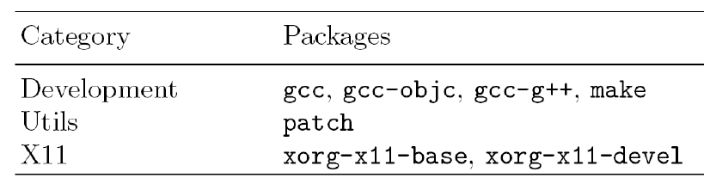
Installation: Cygwin
• Cygwin = Linux emulation for windows
1. Go to Cygwin Webpage: http://www.cygwin.com/
2. Get the package
3. Install the basic package
4. Install the following additional packages:
Note: You may ignore warning about X11 packages
Textbook: T. Issariyakul and E. Hossain, Introduction to Network Simulator NS2, Springer 2008.
13
Notes:
Cygwin/X is an implementation of the X Window System that runs under Microsoft Windows. It is part of the Cygwin project, and is installed using Cygwin's standard setup system. Cygwin/X is free software, licensed under the X11 License.

Slide 15
Installation: Environment
•
•
Add NS2 environment variables for ns2.28
In file <home>/.bashrc, add the following lines
export NS_HOME="/usr/local/ns-allinone-2.28“
export PATH="$PATH: $NS_HOME/ns-2.28: $NS_HOME/nam-1.11: $NS_HOME/bin: $NS_HOME/tcl 8.4.5/unix: $NS_HOME/tk8.4.5/unix“
export LD_LIBRARY_PATH="$LD_LIBRARY_PATH: /$NS_HOME/otcl-1.9: $NS_HOME/lib“
export TCL_LIBRARY="$TCL_LIBRARY: /$NS_HOME/tcl8.4.5/library"
Textbook: T. Issariyakul and E. Hossain, Introduction to Network Simulator NS2, Springer 2008.
14

Slide 16
Outline
•
•
•
•
•
Overview
Installation
An Example
Incorporate C++ Modules into NS2
Summary
Textbook: T. Issariyakul and E. Hossain, Introduction to Network Simulator NS2, Springer 2008.
15

Slide 17
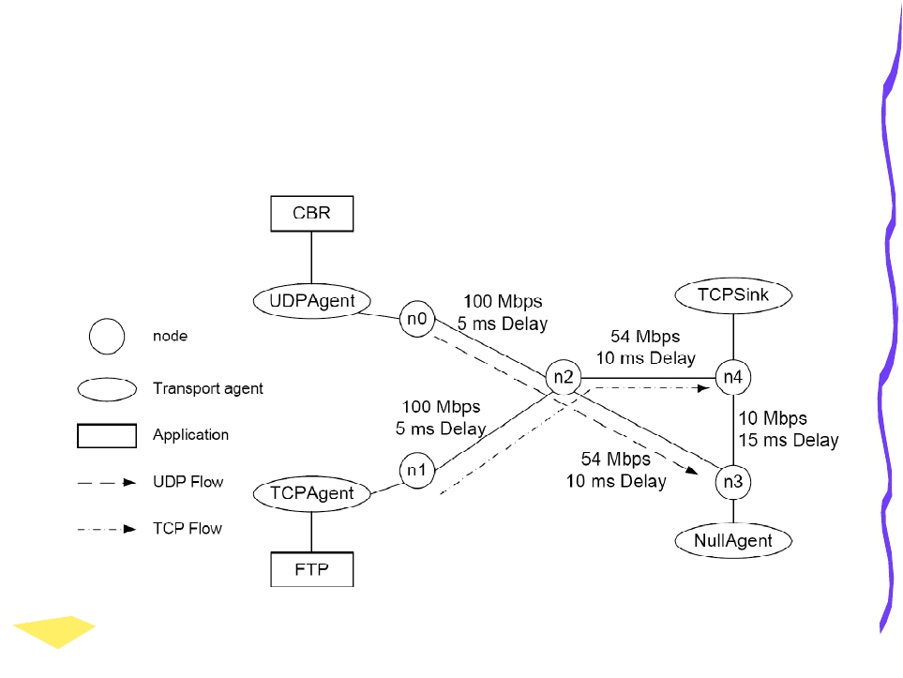
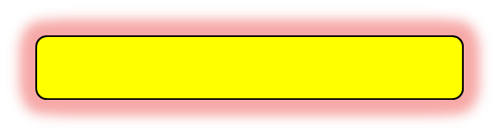
A Network Simulation Example
Note: you can only run nam and Xgraph in a graphical environment (rather than a linux terminal); otherwise, you will see error messages such as, “xgraph: cannot open display `‘” or “nam: no display name and no $DISPLAY environment variable”
Enter to ssh configuration
Run the example from Linux terminal (assume that current directory is <home>):
  >>cd wmn_class_exp\wmn_lab_exp\first_ns
  >>ns myfirst_ns.tcl
Run the example from Linux graphical environment (by teacher)
  run “remote desktop connection” (with IP address of c408ser00) in classroom PC,…
Textbook: T. Issariyakul and E. Hossain, Introduction to Network Simulator NS2, Springer 2008.
16

Slide 18

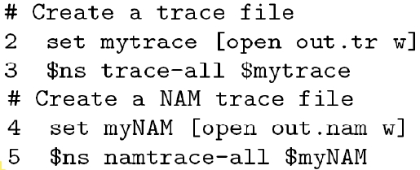
Tcl Simulation Script
• Filename “myfirst_ns.tcl”
• Create a simulator
• Create trace objects
Set the value of ns to the created Simulator object
Open file out.tr for writing
Collect all trace information for a regular trace
Collect all trace information for a NAM trace
Textbook: T. Issariyakul and E. Hossain, Introduction to Network Simulator NS2, Springer 2008.
17

Slide 19
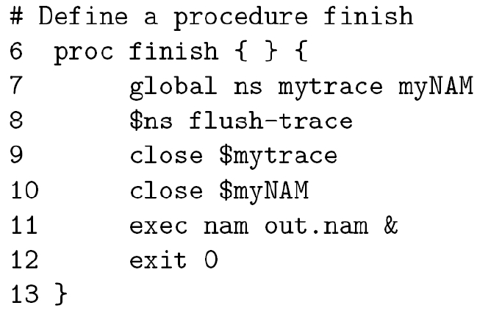
A Network Simulation
Example
• Define a “finish” proceduer
Informs interpreter of the global variables
Flush the buffer of tracing variables
& means "run the command, nam out.nam, in the background”.
In other words, once a program is running in the background, the program will continue to run even if you exit from a Linux terminal.
Textbook: T. Issariyakul and E. Hossain, Introduction to Network Simulator NS2, Springer 2008.
18

Slide 20
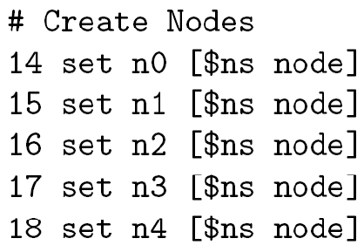
A Network Simulation
Example
• Create nodes
Textbook: T. Issariyakul and E. Hossain, Introduction to Network Simulator NS2, Springer 2008.
19

Slide 21
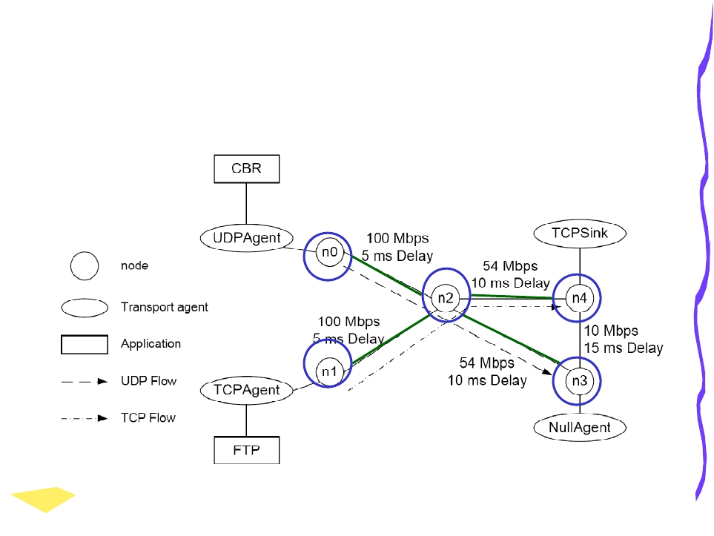
A Network Simulation
Example
Textbook: T. Issariyakul and E. Hossain, Introduction to Network Simulator NS2, Springer 2008.
20

Slide 22
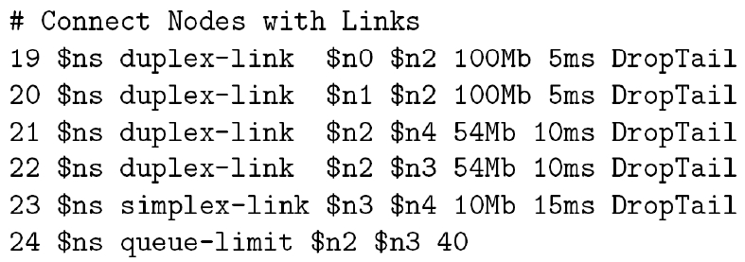
A Network Simulation
Example
• Connect node with “duplex” links
//set max queue size
duplex-link {src dst bw delay queue_type}: create a bi-directional link with some parameters
simplex-link {src dst bw delay queue_type}: create a uni-directional link with some parameters
Textbook: T. Issariyakul and E. Hossain, Introduction to Network Simulator NS2, Springer 2008.
21

Slide 23
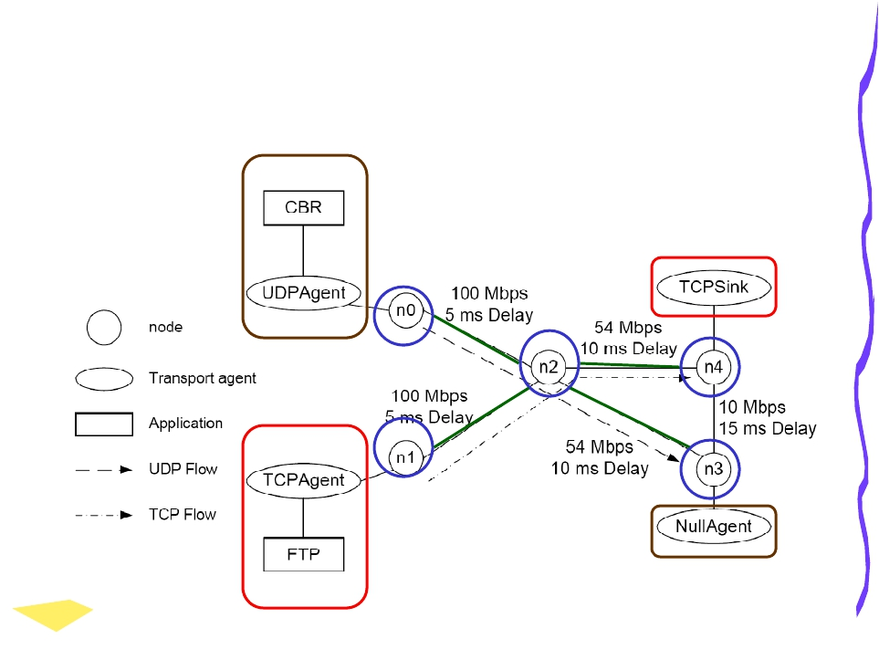
A Network Simulation
Example
Textbook: T. Issariyakul and E. Hossain, Introduction to Network Simulator NS2, Springer 2008.
22

Slide 24
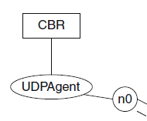
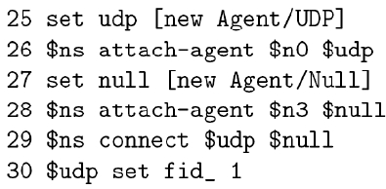

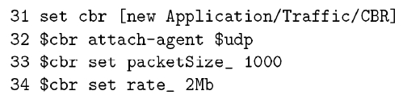
A Network Simulation
Example
• Create a flow from n0 to n3
– Create a UDP flow
– Attach a CBR source to the UDP flow
Attach udp agent and node n0 together
Set the UDP flow ID =1
Attach CBR source to udp agent
Textbook: T. Issariyakul and E. Hossain, Introduction to Network Simulator NS2, Springer 2008.
23

Slide 25
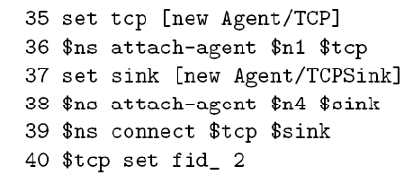

A Network Simulation
Example
• Create a flow from n1 to n4
– Create a TCP flow
– Attach a FTP source to the TCP flow
Textbook: T. Issariyakul and E. Hossain, Introduction to Network Simulator NS2, Springer 2008.
24

Slide 26
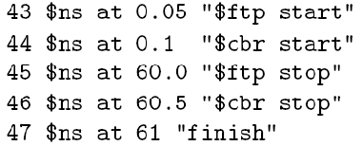

A Network Simulation
Example
• Schedule Events
• Start simulation
Textbook: T. Issariyakul and E. Hossain, Introduction to Network Simulator NS2, Springer 2008.
25

Slide 27
A Network Simulation
Example
•
We are in step two of network simulation
Step 1 = ( Design
)
Step 3 = ( Result Compilation )
Sub-Step The part of the code
1. (Network Configuration) (the rest of the codes
)
2. (Simulation
)
($ns run
)
3. ( ) (
Textbook: T. Issariyakul and E. Hossain, Introduction to Network Simulator NS2, Springer 2008.
)
26

Slide 28
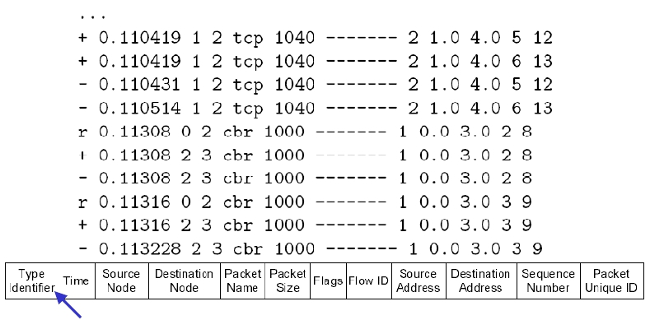
A Network Simulation Example
• Results? ➔ (files out.tr and out.nam )
{enque(+),deque(-),receive(r),drop(d)}
Run the example in Linux:
  >>cd <home>\wmn_class_exp\wmn_lab_exp\first_ns
  >>ns myfirst_ns.tcl
  Read and understand myfirst_ns.tcl
Textbook: T. Issariyakul and E. Hossain, Introduction to Network Simulator NS2, Springer 2008.
27

Slide 29
Outline
•
•
•
•
•
Overview
Installation
An Example
Incorporate C++ Modules into NS2
Summary
Textbook: T. Issariyakul and E. Hossain, Introduction to Network Simulator NS2, Springer 2008.
28

Slide 30
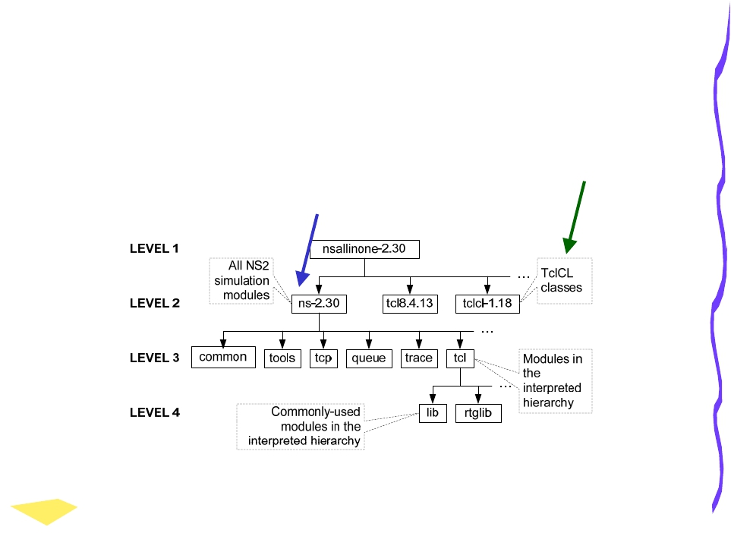
New Modules
• NS2 Modules: C++ and OTcl
• Directories: ~ns
~tclcl
See Also: http://www-rp.lip6.fr/ns-doc/ns226-doc/html/hierarchy.htm
Textbook: T. Issariyakul and E. Hossain, Introduction to Network Simulator NS2, Springer 2008.
29

Slide 31
New Modules
• When adding a new C++ Modules
– Need to recompile and links all NEW
modules
– Use make utility
– Take about 5 seconds to run.
• When adding a new OTcl module
– We can avoid running make utility,
– Define the new module in your simulation
script
Textbook: T. Issariyakul and E. Hossain, Introduction to Network Simulator NS2, Springer 2008.
30

Slide 32
Make Utility
• “make” contains a set of things that will be done
when “make” is executed from the command
prompt.
• Make usage
>> make [-f <filename>]
– Executed what specified in <filename>
– <filename> is called a “file descriptor”
– No file is given ➔ make will read the default “Makefile”
• File descriptor
– Syntax
1:
<target1> [<target2> …]
: [<dep1> <dep2> …]
2:
<command>
– Line 1: Show that target 1 depends on dep1, ….
– Line 2: Regenerate the target file if any of the dependency is changed
Textbook: T. Issariyakul and E. Hossain, Introduction to Network Simulator NS2, Springer 2008.
31

Slide 33
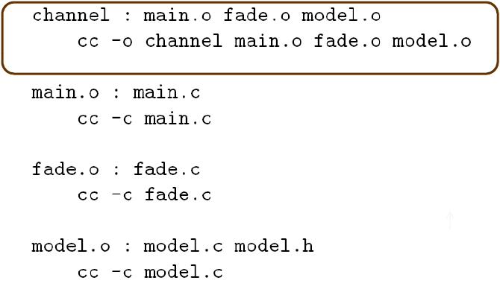
Make Utility
Example:
The executable file channel consists of main.c, fade.c, and model.c
Model.c depends on model.h
Makefile is given as follows and the make utility will read Makefile
#makefile of channel
A comment begins with #
main.o, fade.o, and/or
model.o
In the UNIX command
“cc -c file.c” compiles the file file.c and creates an object file file.o
“cc -o file.o” links the object file file.o and create an executable file file
Textbook: T. Issariyakul and E. Hossain, Introduction to Network Simulator NS2, Springer 2008.
32
Notes:
hyphen [‘haifən], n. 连字号 (-)

Slide 34
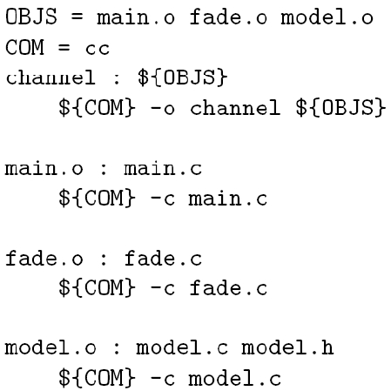
Make Utility
Example: Define a macro to represent a same sequence.
  Use variables OBJS and COM
Textbook: T. Issariyakul and E. Hossain, Introduction to Network Simulator NS2, Springer 2008.
33

Slide 35
Makefile for NS2
• Located in ~ns
• Key components:
– INCLUDES = : Directory
– OBJ_CC = : All NS2 object files
– NS_TCL_LIB = : All NS2 OTcl files
• Put your files in these three
components
Textbook: T. Issariyakul and E. Hossain, Introduction to Network Simulator NS2, Springer 2008.
34

Slide 36
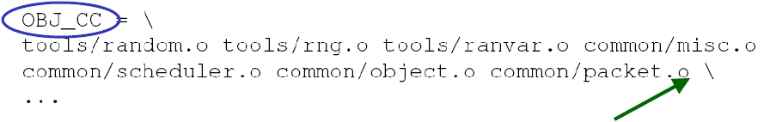
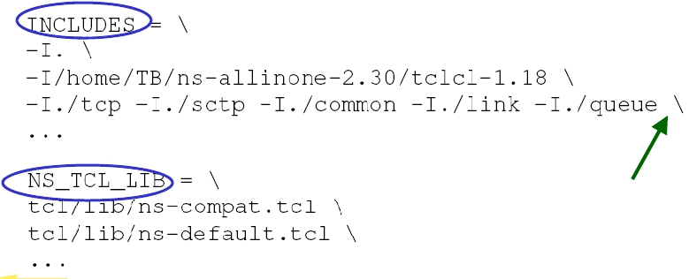
Makefile for NS2: Example
Use *.o
Use “\” to
separate lines
Textbook: T. Issariyakul and E. Hossain, Introduction to Network Simulator NS2, Springer 2008.
35

Slide 37
Outline
•
•
•
•
•
Overview
Installation
An Example
Incorporate C++ Modules into NS2
Summary
Textbook: T. Issariyakul and E. Hossain, Introduction to Network Simulator NS2, Springer 2008.
36

Slide 38
Summary
• NS2 consists of
– OTcl ( user interface ) and
– C++ ( internal mechanism )
• Installation: NS2 + Cygwin
• An Example
• Make utility
– INCLUDE:
Directoryy
– OBJ_CC: C++ Modules
– NS_TCL_LIB: OTcl Modules
Textbook: T. Issariyakul and E. Hossain, Introduction to Network Simulator NS2, Springer 2008.
37

Slide 39
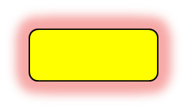
Homework
• Problem 1: Install the NOAH protocol in your Linux (not in our server)
  follow the noah_install.text in directory <home>\wmn_lab_exp\NOAH_install
Problem 2: Run M/M/1 example in Linux
  Run the M/M/1 example (λ= 30 pkts per second; μ = 33 pkts per second)
    >> cd <home>\ wmn_class_exp\wmn_lab_exp\mm1
    >> ns mm1.tcl
    Note: mm1.tcl will call wavg1.awk and wavg2.awk to generate: out1.xgr/out2.xgr
  Read and understand mm1.tcl, wavg1.awk, wavg2.awk
    Simulation results of mean queue for M/M/1:
      wavg1.awk to calculate mean queue in a short term, 1 second
      wavg2.awk to calculate mean queue in a long term, 1000 seconds
    Theoretical results of mean queue for M/M/1
      Mean queue = ρ/(1-ρ) = 10, where ρ= λ/μ
  Plot out1.xgr/out2.xgr using matlab since Xgraph cannot run in a remote terminal.
Solution
Textbook: T. Issariyakul and E. Hossain, Introduction to Network Simulator NS2, Springer 2008.
38

Slide 40
Linux ssh client
Download ssh client to access Linux server
  Download ssh329 from ftp.must.edu.mo/student/commonTools/
  Run sshclient
Configure sshclient
  IP addr of linux ssh server: 10.4.40.89
  Account/password for linux ssh client (# can be found in next page)
    Account/password = stuwm#/123456 for undergraduates
    Account/password = stuwmgrad#/123456 for graduates

Slide 41
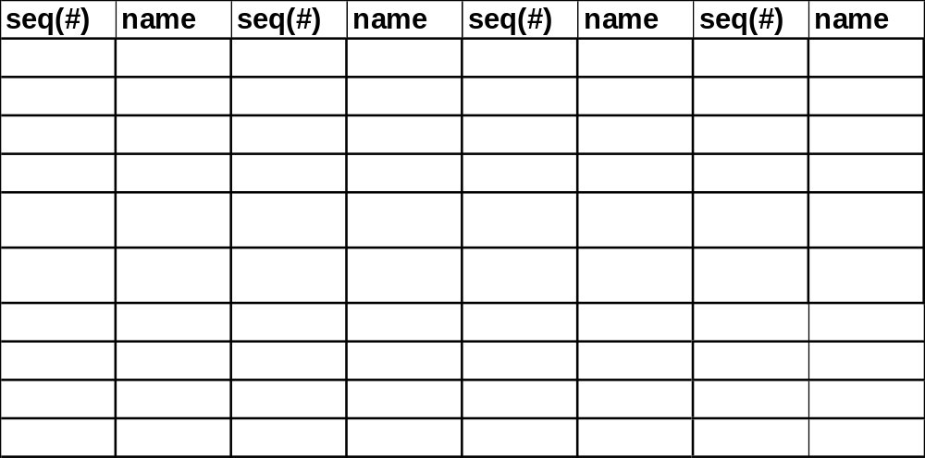
Linux account/password for undergraduates
Usrname/passwd = stuwm#/123456
  # is the sequence number of students.

Slide 42
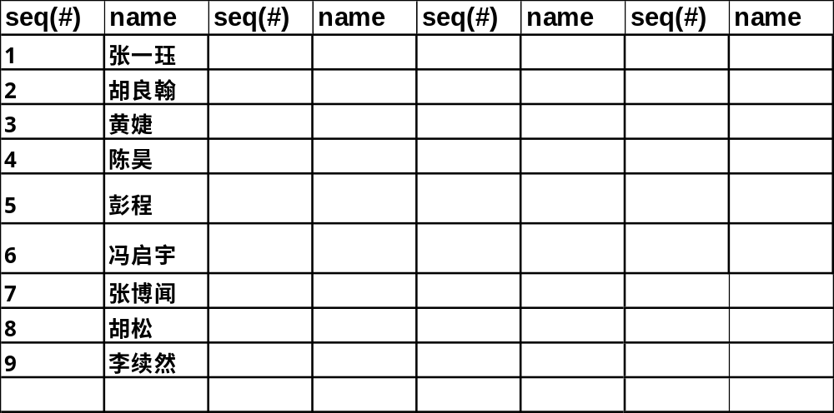
Linux account/password for graduates
Usrname/passwd = stuwmgrad#/123456
  # is the sequence number of students.

Slide 43
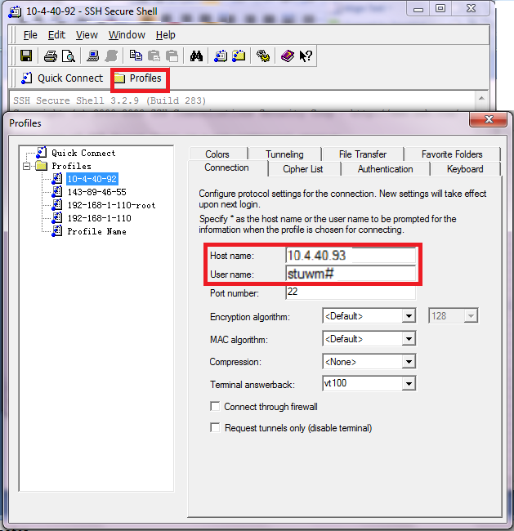
ssh client configuration
10.4.40.89
Please input:
stuwm# or stuwmgrad#

Slide 44
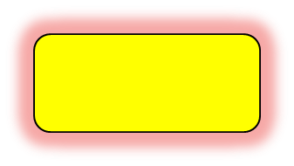
Download VM6FC7_class
Download & run VM with ns2.28
  Prepare a mobile disk (≥12G free space)
  Download VM machine, VM6FC7_class,
    \\c408ser00\shared
    Usrname/passwd= student/Stud1234;
  Run VM machine
    Usrname/passwd=root/123456;
    Require VMware player or station to run VM machine
Return to
the example

Slide 45
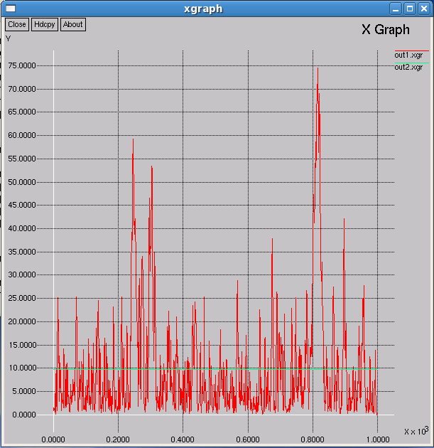
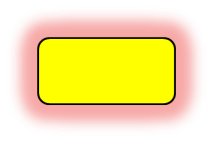
Solution: mean queue for M/M/1
mean queue within 1 second
mean queue within 1000 seconds
The long-term simulation mean queue = theoretical mean queue = 10
Return

